Slide 1
SECURE DATA HIDING IN IMAGES USING STEGANOGRAPHY
CAPSTONE PROJECT
Presented By: Deepak Kumar
Student Name : Deepak Kumar
College Name & Department : Maharishi Markandeshwar (Deemed to be University) & MMICT&BM (BCA)

Slide 2
OUTLINE
Problem Statement
Technology used
Wow factor
End users
Result
Conclusion
Git-hub Link
Future scope

Slide 3
Problem Statement
With the rise in digital communication, data security has become a major concern. Traditional encryption methods are effective but can attract unwanted attention. Steganography offers a way to securely transmit information by embedding data within images, making it invisible to unintended viewers. This project aims to develop a system for securely hiding and retrieving data within images using advanced steganographic techniques.

Slide 4
Technology used
Programming Language: Python
Libraries: OpenCV, NumPy, Pillow
Steganography Techniques: Least Significant Bit (LSB) encoding
Graphical User Interface: Tkinter (optional)
Security Enhancements: AES encryption for additional protection

Slide 5
Wow factors
The project integrates encryption with steganography, adding an extra layer of security.
Supports embedding data in multiple image formats with minimal quality loss.
User-friendly interface for encoding and decoding hidden messages.
High capacity for data embedding while maintaining image integrity.

Slide 6
End users
Individuals looking for secure private communication.
Government agencies and law enforcement for confidential information exchange.
Journalists and whistleblowers needing to protect sensitive sources.
Cybersecurity professionals and ethical hackers exploring data security solutions.

Slide 7
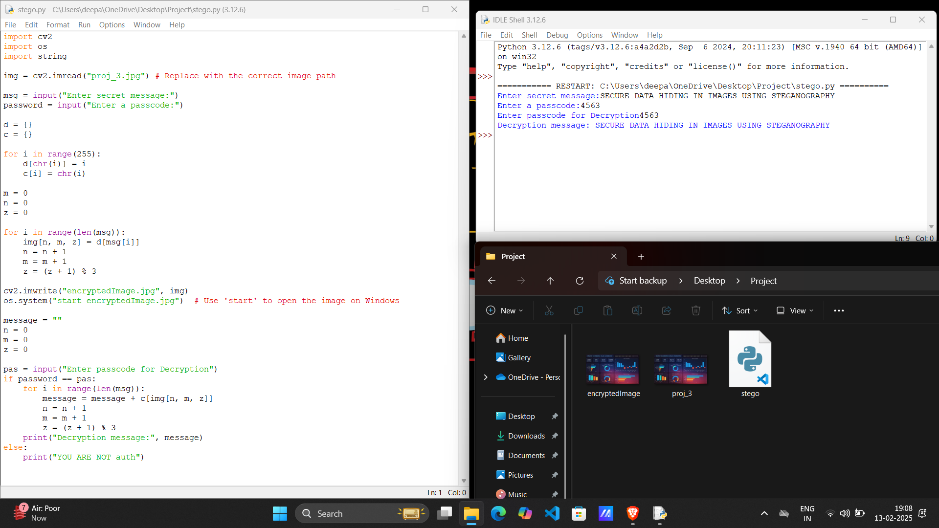
Results

Slide 8
Conclusion
Steganography is a powerful tool for secure data transmission. This project effectively showcases how images can be used as carriers for sensitive data, making communication more secure and discreet. By combining encryption with steganography, we can further enhance security and ensure that hidden messages remain undetectable.

Slide 9
GitHub Link
GITHUB LINK:- https://github.com/deepakshroff/AICTE_Project

Slide 10
Future scope(optional)
Implementing deep learning techniques for enhanced steganographic security.
Extending support for video steganography.
Developing a mobile application for on-the-go secure messaging.
Adding watermarking techniques for copyright protection.
Improving efficiency for large-scale data hiding without compromising image quality.

Slide 11
THANK YOU

